Slide 1
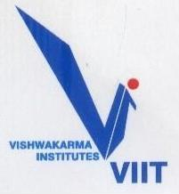
Project Phase – I , Presentation on “Image Stitching”
(Domain : Digital Image Processing)
By : Group No. – A5
Under Guidance of Prof. Dr. Y. H. Dandawate
Roll No. | Division | Name of Student
411003 | A | Aditya Kumar Gautam
411019 | A | Saurabh Damle
411067 | A | Sanket Satish Jadhav
411039 | A | Sudhamsu Guduru
Bansilal Ramnath Agarwal Charitable Trust’s
Vishwakarma Institute of Information Technology
Department of Electronics & Telecommunication

Slide 2
PROJECT PHASE – I, outline
INTRODUCTION
LITERATURE SURVEY
MOTIVATION
OBJECTIVES
BLOCK DIAGRAM
METHODOLOGY
HARDWARE AND SOFTWARE SPECIFICATION
RESULT ANALYSIS AND DISCUSSION
APPLICATIONS
FUTURE SCOPE
IMPLEMETATION PLAN
REFERENCES
Bansilal Ramnath Agarwal Charitable Trust’s
Vishwakarma Institute of Information Technology
Department of Electronics & Telecommunication

Slide 3
INTRODUCTION
The process of taking photographs which are ordered in collection of the scene is called a Panorama.
Let us say that you need to capture a big scene, but our camera has a limited field of view and a specific resolution of image, this is certainly not enough to capture the scene.
With the existing hardware we can capture multiple images of the respective scene and put them together by matching some part of the previous image with the next, forming one image that is the big scene which had to be captured. This is a good idea about having the big scene with some process behind.
The outcome will be one big image of the scenic view.
Bansilal Ramnath Agarwal Charitable Trust’s
Vishwakarma Institute of Information Technology
Department of Electronics & Telecommunication

Slide 4
LITERATURE SURVEY
Paper on SIFT:-
Using sequence of images to create a panorama was done earlier by Lowe (2004) and Zaleski (2004). They used the process of feature matching, image matching and Bundle adjustment. The first step in the panoramic recognition algorithm is to extract and match SIFT features between all of the images.
SIFT features are located at scale-space maxima/minima of a difference of Gaussian function. In image matching the objective is to find all matching (i.e. overlapping) images. Connected sets of image matches will later become panoramas. Given a set of geometrically consistent matches between the images, we use bundle adjustment to solve for all the camera parameters jointly. Automatic Panorama Straightening technique is used to correct the slight tilt in the adjacent image frames when they are being stitched together.
Bansilal Ramnath Agarwal Charitable Trust’s
Vishwakarma Institute of Information Technology
Department of Electronics & Telecommunication

Slide 5
MOTIVATION AND OBJECTIVES
MOTIVATION:
Large structures like windmills are continuously exposed to harsh weather and prone to fatigue and serious damage. For this issue Drones fitted with camera are used for inspection by taking videos of the structure.
Now the issue is, watching long videos and processing them to detect damages is time consuming, one way to save time would be to look at the entire image of the structure at once but if entire structure is photographed at once very expensive camera would be required a the image would have to be taken from large distance so as to cover the entire structure.
Hence, we are working on a solution to take videos of the structure using a drone from a proximity to get higher clarity from a cheaper and low-resolution camera forming an image of the complete structure by extracting images from the video and perform image stitching on those images and form a high-resolution panoramic image.
OBJECTIVES:
Generation of Data set from video.
Feature Detection (Key Point Detection).
Image Registration Techniques.
Developing panorama of different Scales.
Determine quality of the panoramic Image.
Bansilal Ramnath Agarwal Charitable Trust’s
Vishwakarma Institute of Information Technology
Department of Electronics & Telecommunication

Slide 6
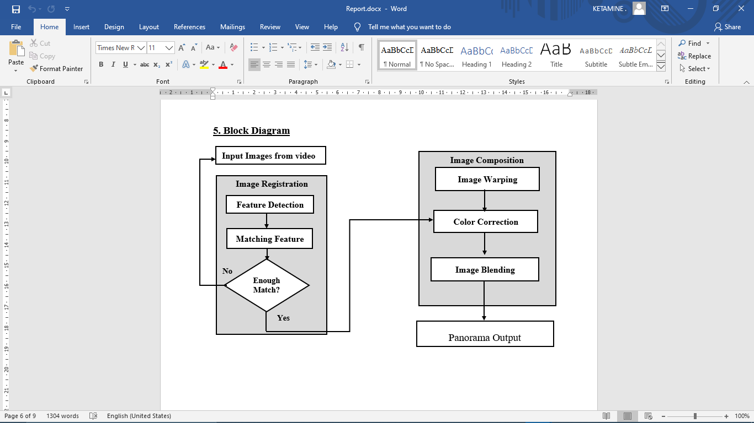
BLOCK DIAGRAM AND METHODOLOGY
METHODOLOGY:
The images will be extracted from the video at fixed frame rate
Image Correspondence will be taken into consideration for the common identified points in back to back images.
Image registration will be necessary in order to be able to compare or integrate the images obtained from these different continuous images.
Enough match will be checked, and Image composition which describes how different subjects and visual elements are arranged inside of the image frame will be performed.
Bansilal Ramnath Agarwal Charitable Trust’s
Vishwakarma Institute of Information Technology
Department of Electronics & Telecommunication

Slide 7
HARDWARE AND SOFTWARE SPECIFICATION
SOFTWARE:
MATLAB/ PYTHON
HARDWARE:
No hardware required
APPLICATIONS
Image Stabilization feature that use frame-rate image alignment
Image Stabilization feature that use frame-rate image alignment
High-resolution photo in digital maps and Satellite photos
Medical imaging
Bansilal Ramnath Agarwal Charitable Trust’s
Vishwakarma Institute of Information Technology
Department of Electronics & Telecommunication

Slide 8
APPLICATIONS
Multiple image super resolution
Video stitching
Object insertion
Video stabilization
Video matting
Panorama
FUTURE SCOPE
Further application of this image can be taking close photos of a large structures and stitch images from all sides . Machine Learning algorithms can be developed to automatically identify cracks from the final Panoramic Image.
Bansilal Ramnath Agarwal Charitable Trust’s
Vishwakarma Institute of Information Technology
Department of Electronics & Telecommunication

Slide 9
References
Mathew Brown and David G. Lowe Automatic Panoramic Image Stitching using Invariant Features.
Open CV Documentation.
Zhen Quin, “Image Stitching Technology”
Bansilal Ramnath Agarwal Charitable Trust’s
Vishwakarma Institute of Information Technology
Department of Electronics & Telecommunication

Slide 10
Thankyou!
Bansilal Ramnath Agarwal Charitable Trust’s
Vishwakarma Institute of Information Technology
Department of Electronics & Telecommunication

